Slide 1

Churn Prediction in a bank
Ingrid mongori yondo
Daft nov21

Slide 2

PRESENTATION
Domain: Finance
Data Source: Kaggle
Business Case: Using financial data to predict customer churn in a bank.
Goal: Help the management team to predict whether or not the customer left the bank.

Slide 3
PLAN
DATA COLLECTION
EDA
DATA CLEANING
RESULTS
MODELS
Shape
Supervised ML
Unsupervised ML
Silhouette score
Accuracy score
Insights
Kaggle
Encoding
Undersampling
Remove Outliers
Imbalance
Target
EVALUATION
DATA MAP
Description of the variables
Confusion matrix

Slide 4
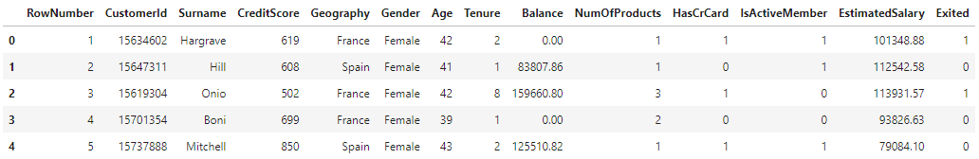
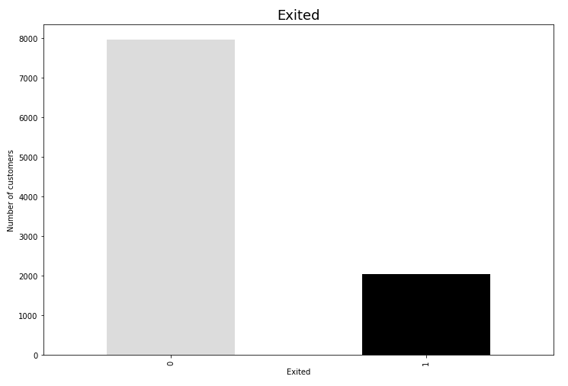
EDA
Shape: 10000 rows and 14 columns
Target: Exited — whether or not the customer left the bank. This is what we have to predict. (0=No,1=Yes)
Imbalance data: 0: 7963 – 1: 2037
Insights on Streamlit

Slide 5
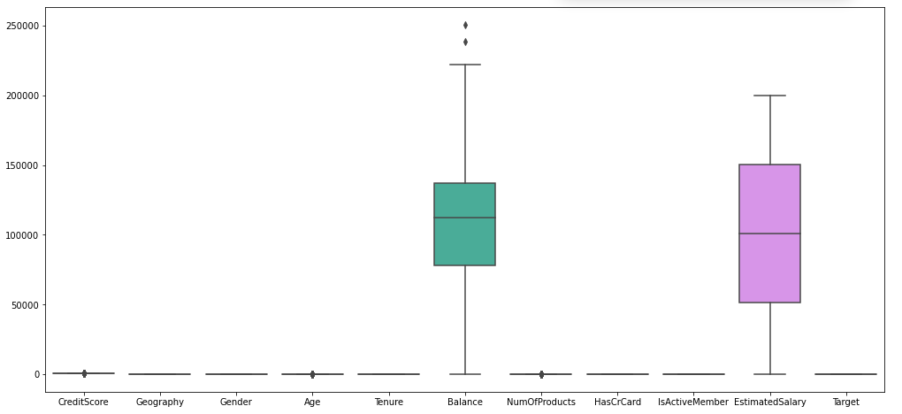
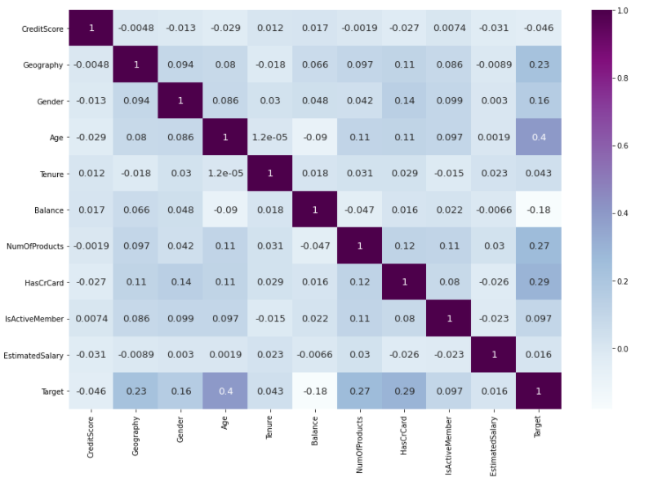
DATA CLEANING
We don’t have any missing values or duplicates.
3 columns dropped: ‘RowNumber’, ‘CustomerId’ and ‘Surname’.
Encoding: Label encoder method for 2 columns ‘Geography’ and ‘Gender’.
Undersampling method (imblearn) → new shape: 4074 rows and 11 columns.
Remove 2 outliers → new shape: 4072 rows and 11 columns.
Outliers - Boxplots
Correlation matrix - Heatmap

Slide 6

MODELS
Supervised machine learning
Unsupervised machine learning
Features Selection
Hyperparameters tuning
3 models: SVC, ExtraTreesClassifier and RandomForestClassifier
KMEANS: Elbow Method
DBSCAN
We had to scale our data for all the models used in Machine Learning!!

Slide 7
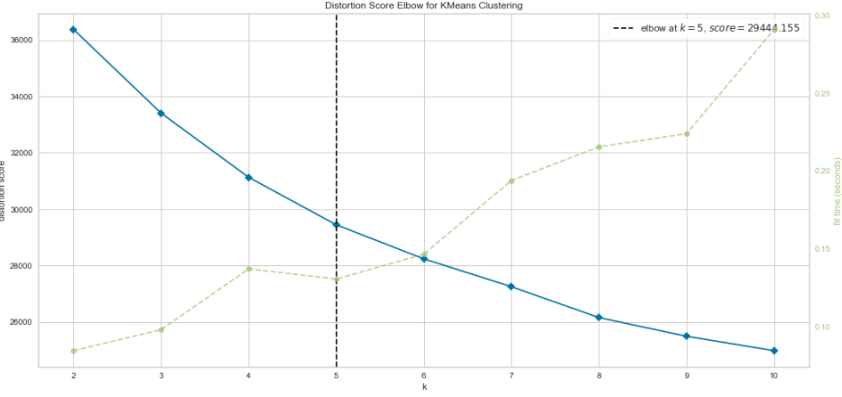
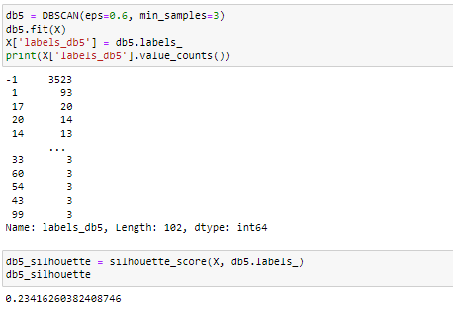
UNSUPERVISED ML EVALUATION
1. Kmeans : Optimum k = 5
2. DBSCAN : eps = 0,6 and min_samples = 3
Elbow Method
 | Max Silhouette score
Kmeans | 0,1987
DBSCAN | 0,2341

Slide 8
SUPERVISED ML EVALUATION
We test on 20% of the data.
Features Selection
Hyperparameters tuning: RandomizedSearchCV
Methods | Features
SFM | 4: ['CreditScore', 'Age', 'Balance', 'EstimatedSalary']
RFE | 5 : ['CreditScore', 'Age’, ‘Tenure’, 'Balance', 'EstimatedSalary']
RFECV | All features
Methods | Best parameters and score
SVC | {'gamma': 'scale', 'C': 45} - 0.8008
ExtraTreesClassifier | {'n_estimators': 285, 'max_depth': 15} - 0.8288
RandomForestClassifier | {'n_estimators': 355} - 0.8315

Slide 9
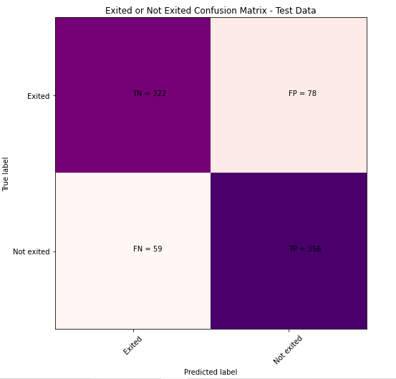
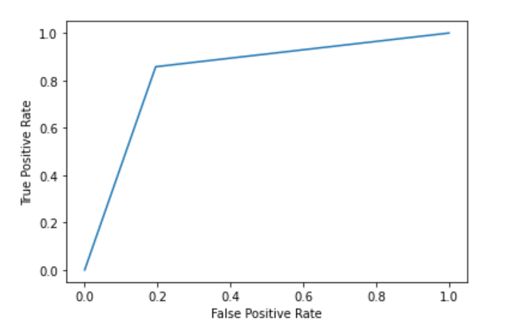
RESULTS
RandomForestClassifier is the best model :
It's closer to 1, the model recognize more and less the 2 classes and every prediction it makes looks correct.

Slide 10

QUESTIONS

